Slide 1
CI/CD comparison:
Github actions vs Codepipeline

Slide 2
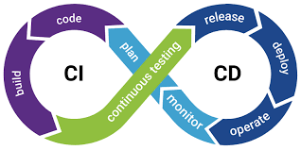
CI/CD

Slide 3
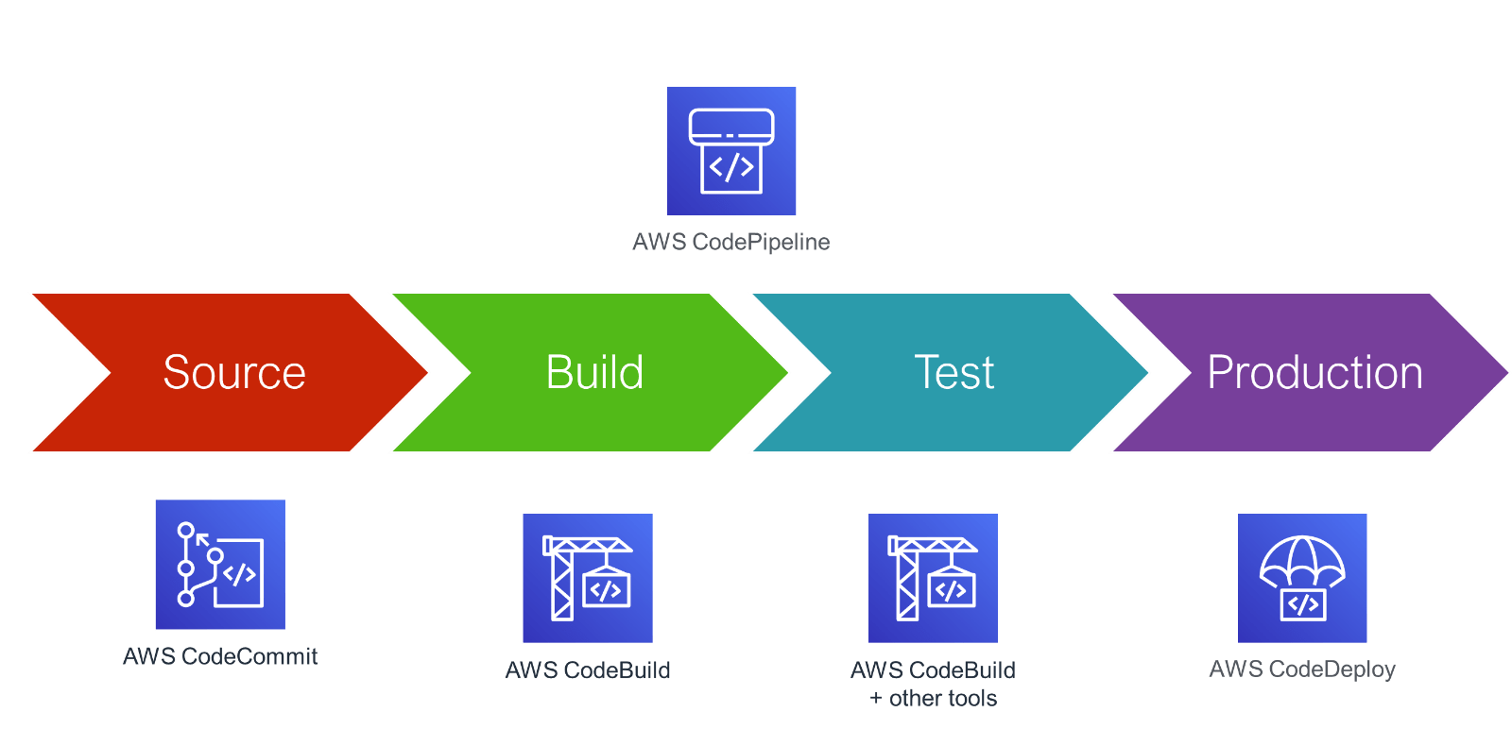
AWS CodePipeline

Slide 4
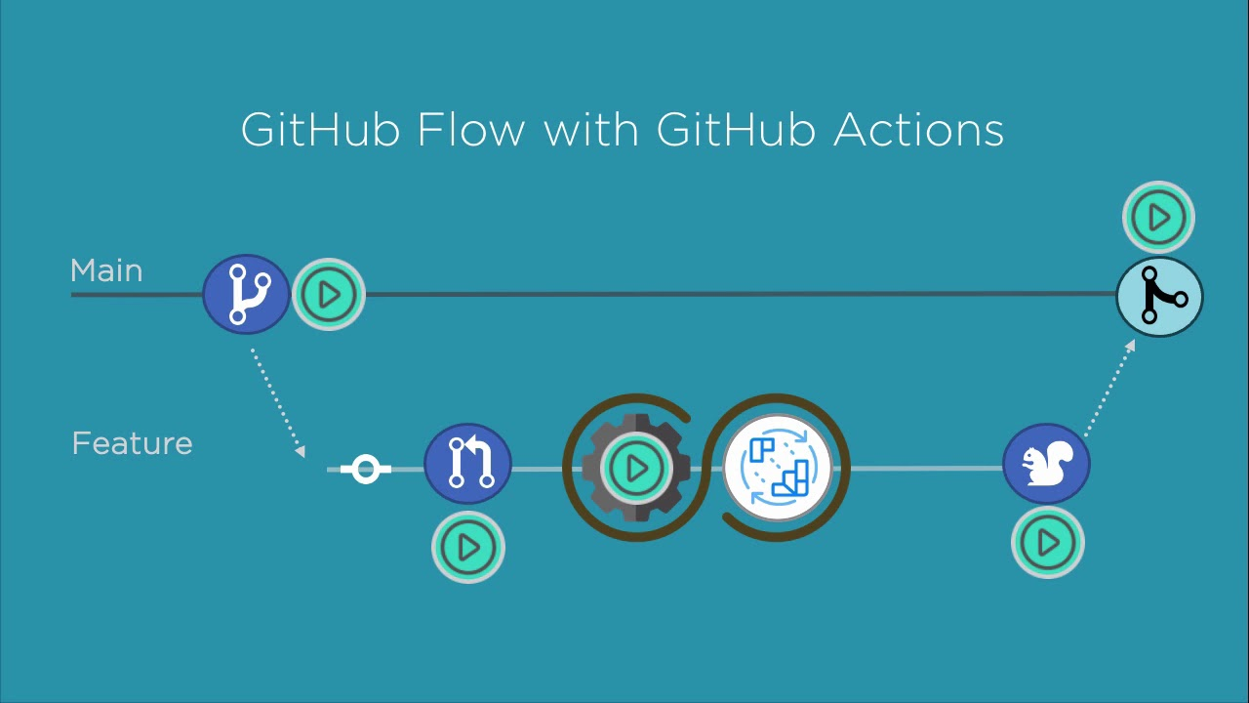
GitHub Actions

Slide 5
Comparison – Creating S3 bucket

Slide 6
Thank You

